Slide 1
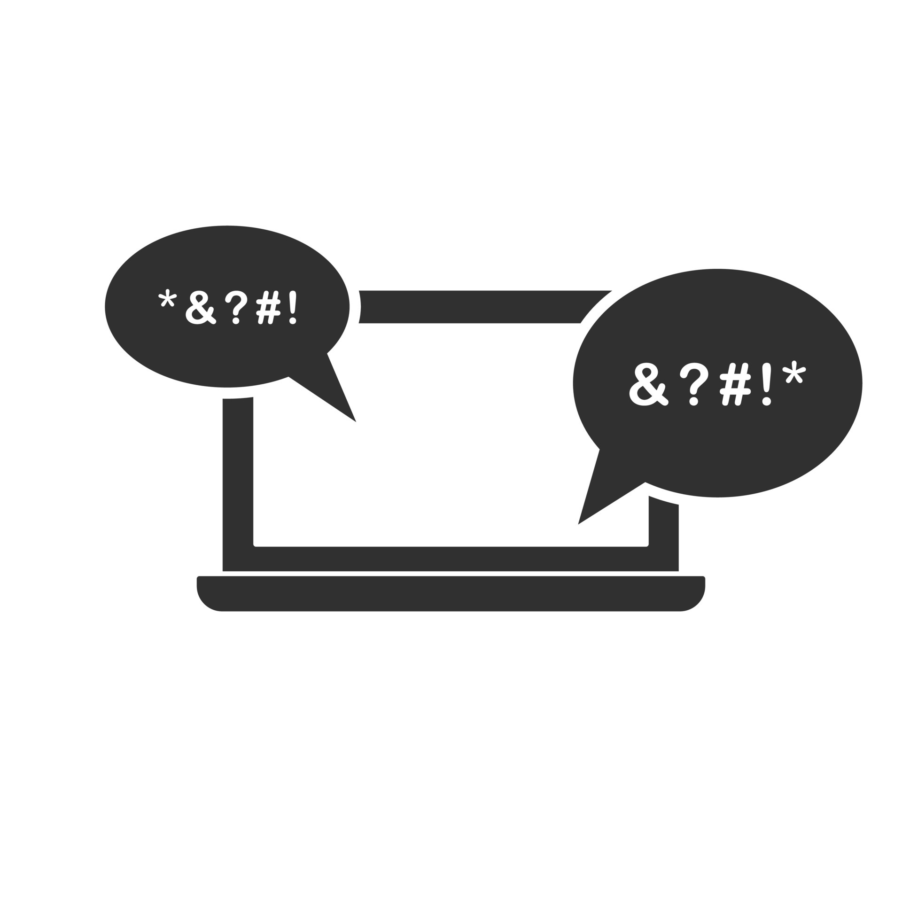
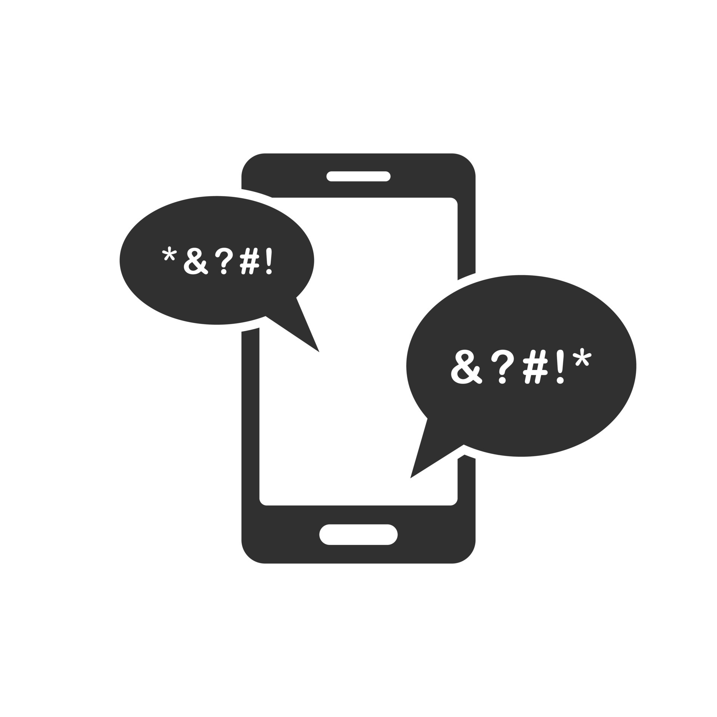
FLAGGING CYBERBULLYING on twitter for Be Kind Org.
SABINA BAINS
August 2022

Slide 2
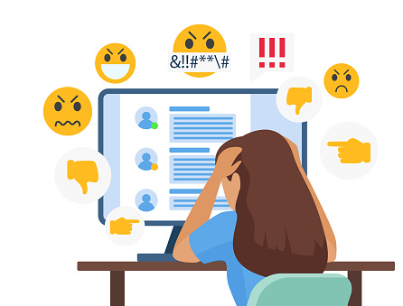
BUSINESS objective
Changes in Twitter leadership could lead to a rise in hate speech and misinformation online
BeKind Org. will create a browser extension to flag potentially harmful tweets
A predictive model is needed to accurately flag instances of cyberbullying

Slide 3
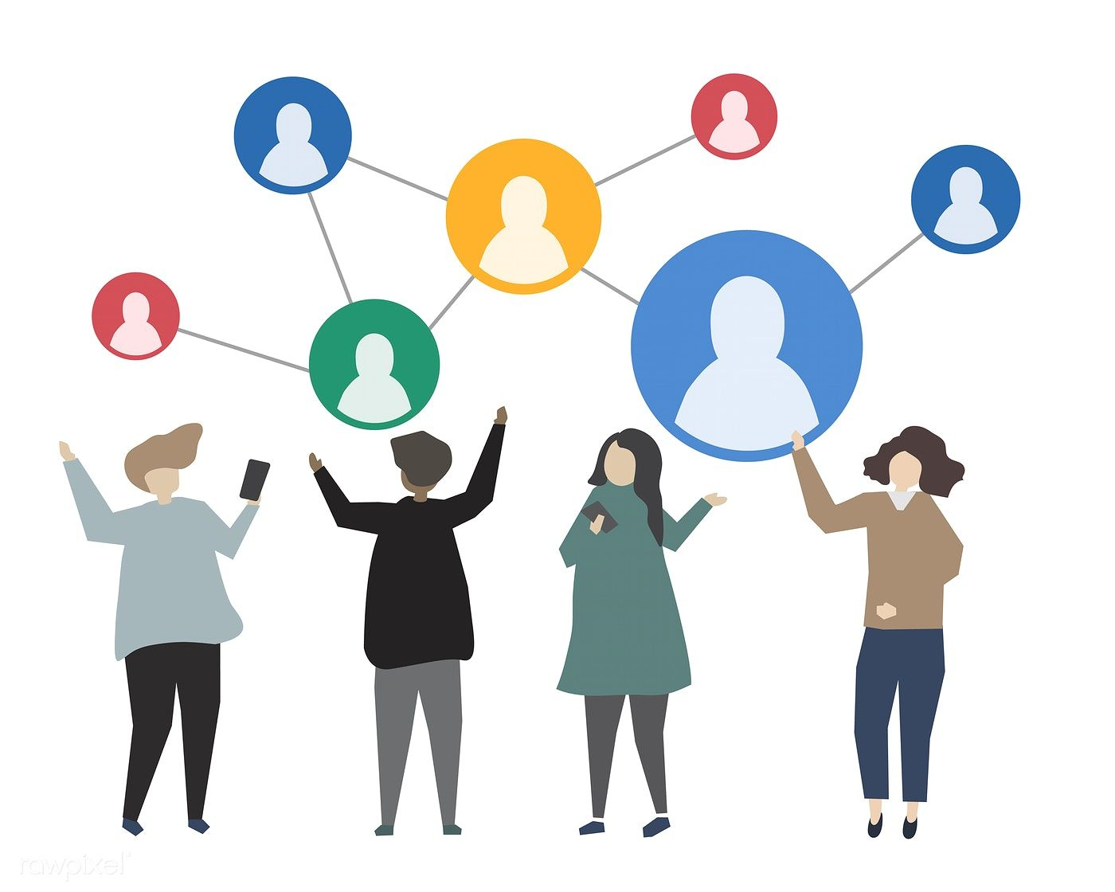
Our solution
Utilize real tweets that have already been manually flagged by type of cyberbullying
Process tweets such that a predictive model can understand words the same way human beings can
Train dataset using Neural Networks
An algorithm inspired by the biological neural networks that constitute the human brain
Data source: https://www.kaggle.com/code/anayad/classifying-cyberbullying-tweets/data

Slide 4
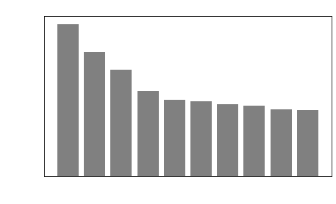
DATA exploration and processing
Frequency Distribution Of Top Words Used in Cyberbullying Tweets
Data used for prediction consists of 47K tweets labeled according to the class of cyberbullying:
Age
Ethnicity
Gender
Religion
Other types of cyberbullying
Not cyberbullying
Standardization and elimination are performed for model efficiency
“Bullies” and “Bullied” become “bulli”
Words such as “the”, “a”, “and” etc. will be removed
Data source: https://www.kaggle.com/code/anayad/classifying-cyberbullying-tweets/data

Slide 5
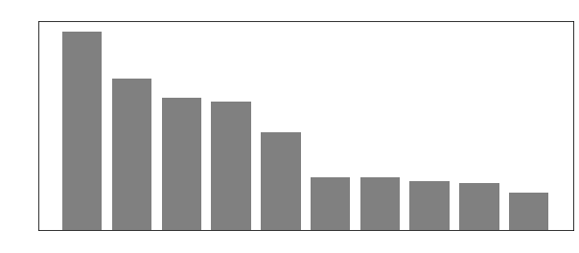
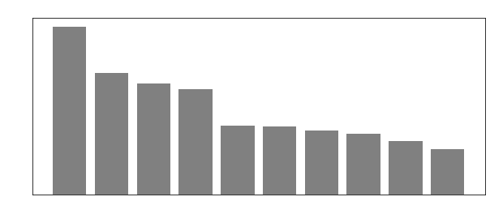
DATA exploration and processing
The most common words for most Cyberbullying categories are unique
However, “Not Cyberbullying” and “Other Cyberbullying” had a high overlap in word usage
Neural Networks are needed so our model can understand the order of words used
Data source: https://www.kaggle.com/code/anayad/classifying-cyberbullying-tweets/data

Slide 6
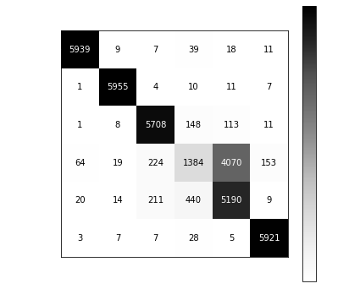
Evaluation of Final model
Matrix of True and Predicted Values
Our model predicted the correct label 82% of the time
The model was less efficient classifying “other” types of cyberbullying with “non-bullying”
This model correctly predicted non-bullying tweets 32% of the time
Data source: https://www.kaggle.com/code/anayad/classifying-cyberbullying-tweets/data

Slide 7

Recommendations / next steps
Implement this model as a starter for the browser extension and continue to gather data to improve accuracy in models.
Remove “other” classification of cyberbullying as it is too vague.
Include a flag for tweets with misleading or incorrect data articles, as the rise in these types of tweets can also negatively affect users.

Slide 8
Thank you
Sabina Bains
Email: Sabinabains3@gmail.com
LinkedIn:
https://www.linkedin.com/in/sabina-bains-a58645a6/

